Slide 1
GPGPU Processing in CUDA Architecture and Square Matrix Multiplication Using CUDA
S2 2023 FIT3143 Assignment 3
Research in Parallel and Distributed Computing
Presented by:
Diong Chen Xi 32722656
16 October 2023

Slide 2
Agenda
Introduction and Background
Problem Statement and Hypothesis
Related Work
Methodology
Proof of Concept Demonstration
Analysis of Results
Conclusion

Slide 3
Introduction and Background

Slide 4
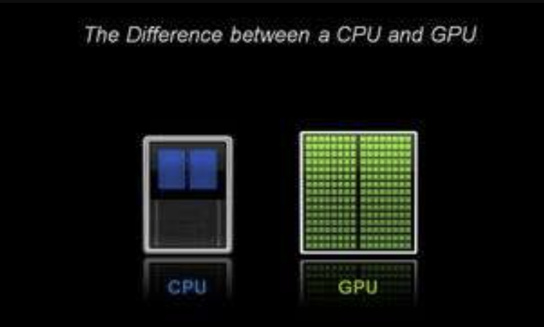
Introduction and Background
Graphical Processing Unit (GPU)
Single-chip processor
Hundreds – thousands of cores
General Purpose GPU (GPGPU)
Using the GPU for non-graphical processing
Low time complexity for complex mathematical operations
Achieves instruction-level parallelism
Compute Unified Device Architecture (CUDA)
NVIDIA®’s GPU architecture
C/C++ programming language extension
Single Instruction Multiple Data (SIMD) parallel processing
Figure 1 : Core Comparison between CPU and GPU (Caulfield, 2009)

Slide 5
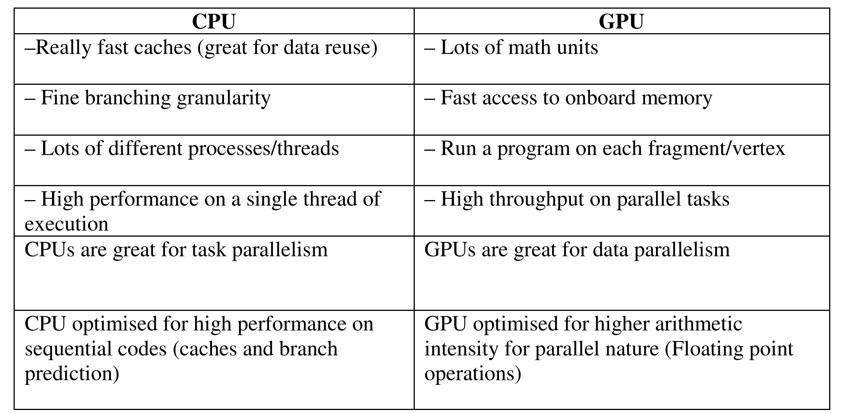
Introduction and Background
Table 1 : Comparison between CPU and GPU (Ghorpade et al., 2012)

Slide 6
Problem Statement and Hypothesis

Slide 7
Problem Statement and Hypothesis
Problem Statement:
Can a graphics processor be leveraged to perform general parallel tasks, with faster computation than a CPU? (Ghorpade et al., 2012)
Hypothesis:
CUDA can fully utilize the power of NVIDIA® GPUs to dramatically increase computing performance.
Research Gaps:
Paper 1
No examples and explanation of general parallel tasks
No clear demonstration of computational speedup
No speed comparison between NVIDIA® GPUs
Paper 2
Algorithm could be further improved with hybrid techniques (CUDA with OpenMP)

Slide 8
Related Work

Slide 9
Related Work
A CUDA version of the Finite-Difference Time-Domain (FDTD) Method to reduce computational time (De Donno et al., 2010).
A GPGPU-based Parallel Particle Swarm Algorithm to solve large size optimization problems (Cádenas-Montes et al., 2011).
Used hypergraph partitioning technique with CUDA and GPU to parallelize matrix multiplication (Murni et al., 2017).
Memory-saving matrix multiplication algorithm for NVIDIA Pascal GPUs (Nagasaka, Nukada & Matsuoka, 2017).
CUDA programming model – CUDA based matrix multiplication algorithms (Hochberg, 2012).

Slide 10
Methodology

Slide 11
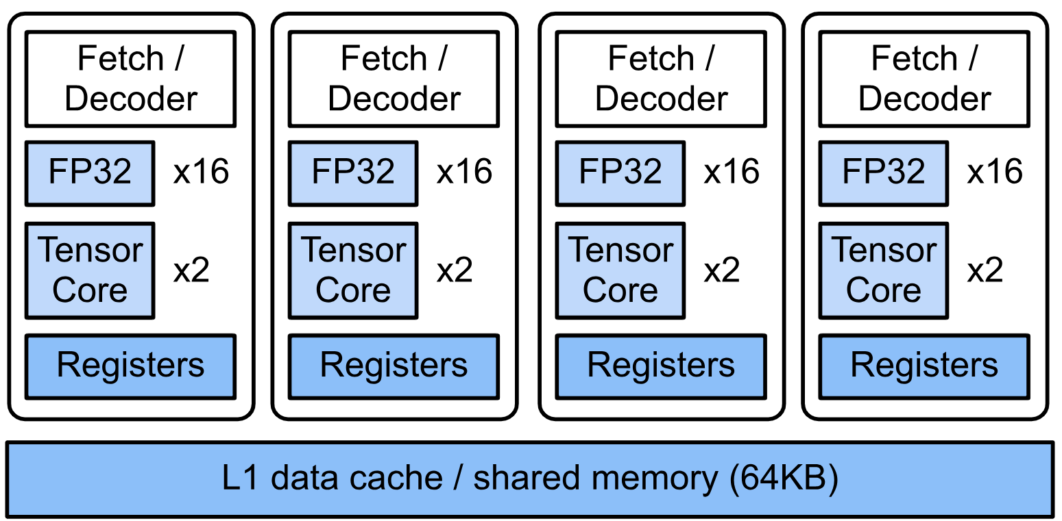
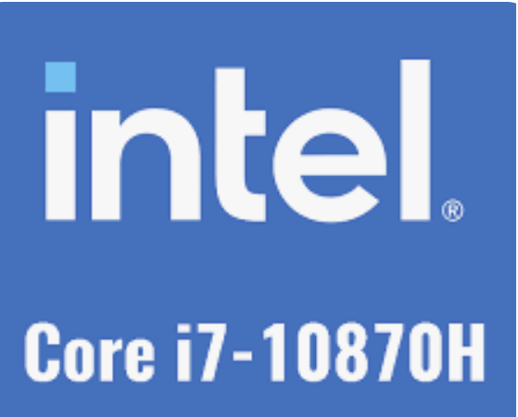
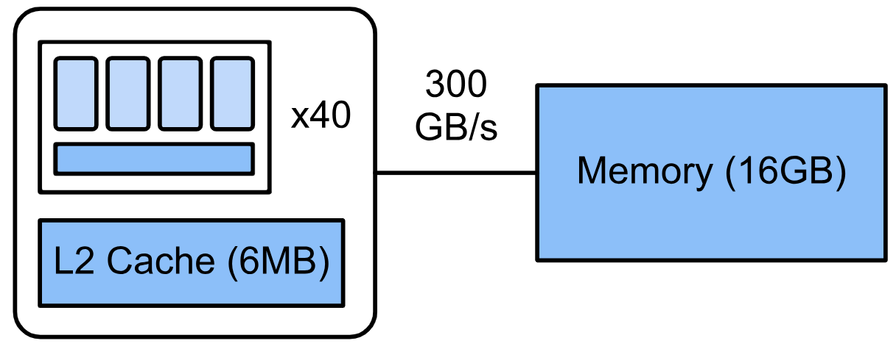
Methodology
V.S.
Total Cores: 8
Total Threads: 16
Figure 2 : Architecture of a Tesla T4 Card on Google Colab
Retrieved from arch.ipynb - Colaboratory (google.com)

Slide 12
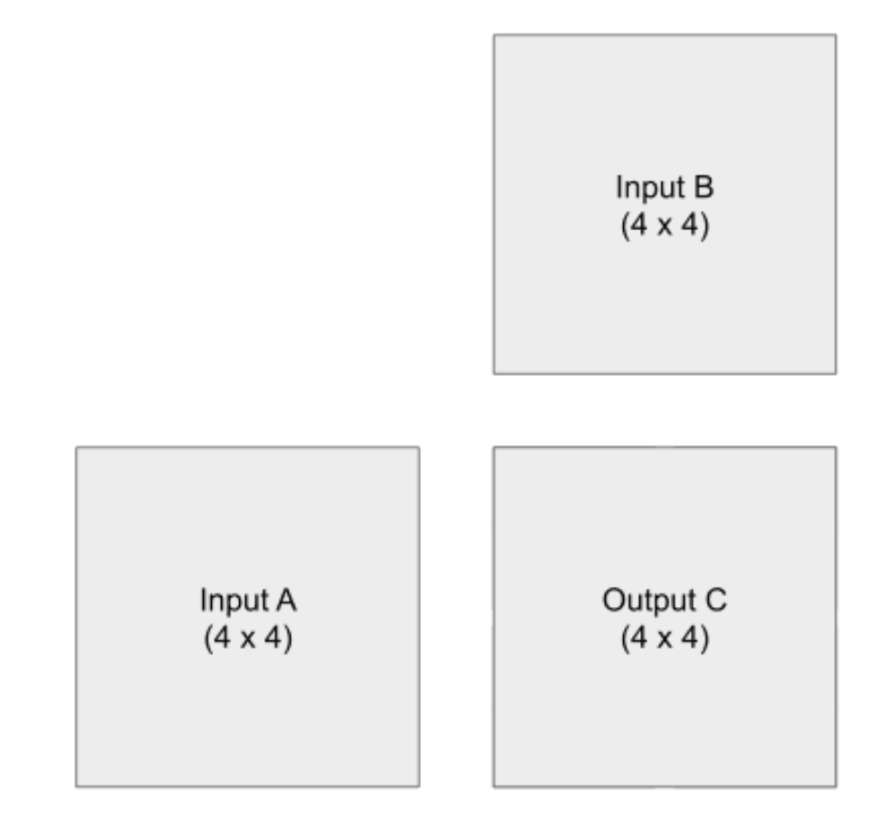
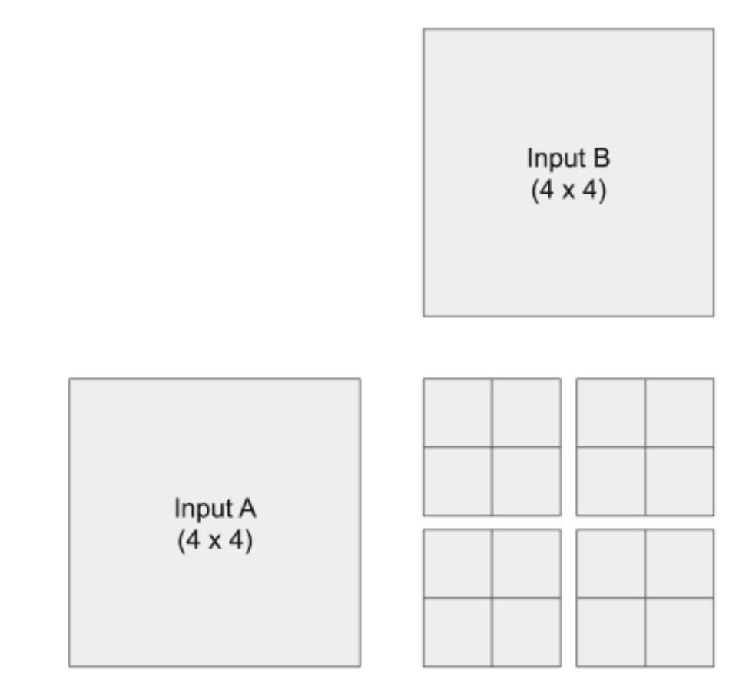
Methodology
Tile-based Square Matrix Multiplication using CUDA (Jimale, Ridzuan, & Zainon, 2019)
Thread
Block
Grid

Slide 13
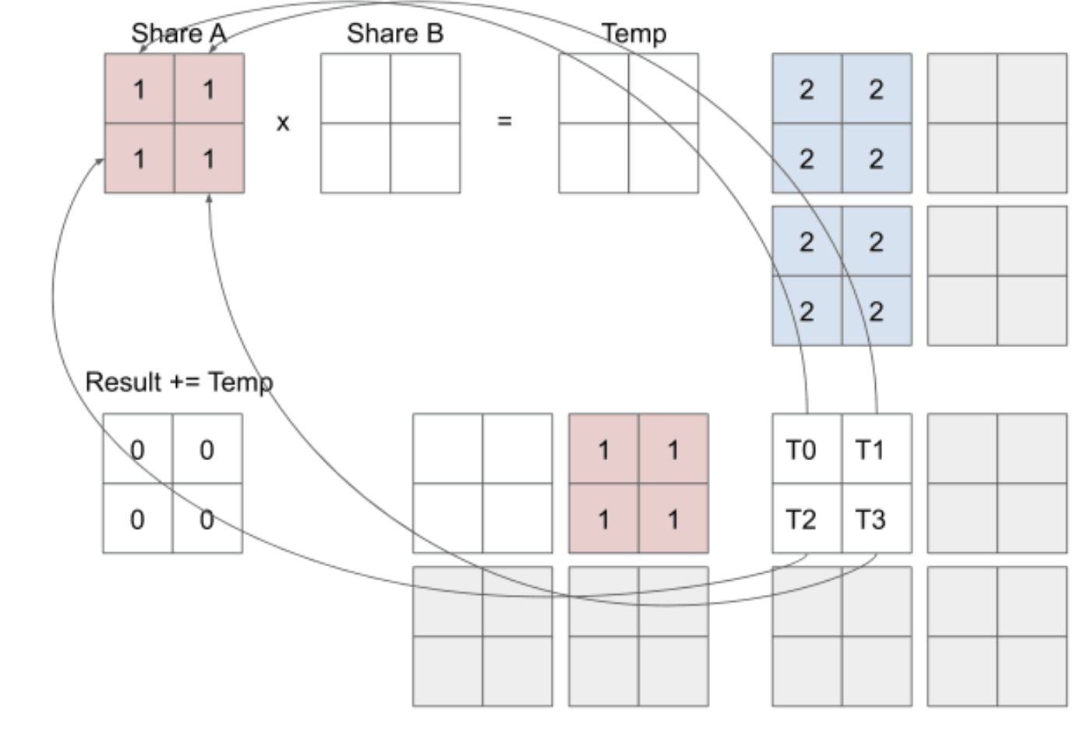
Methodology

Slide 14
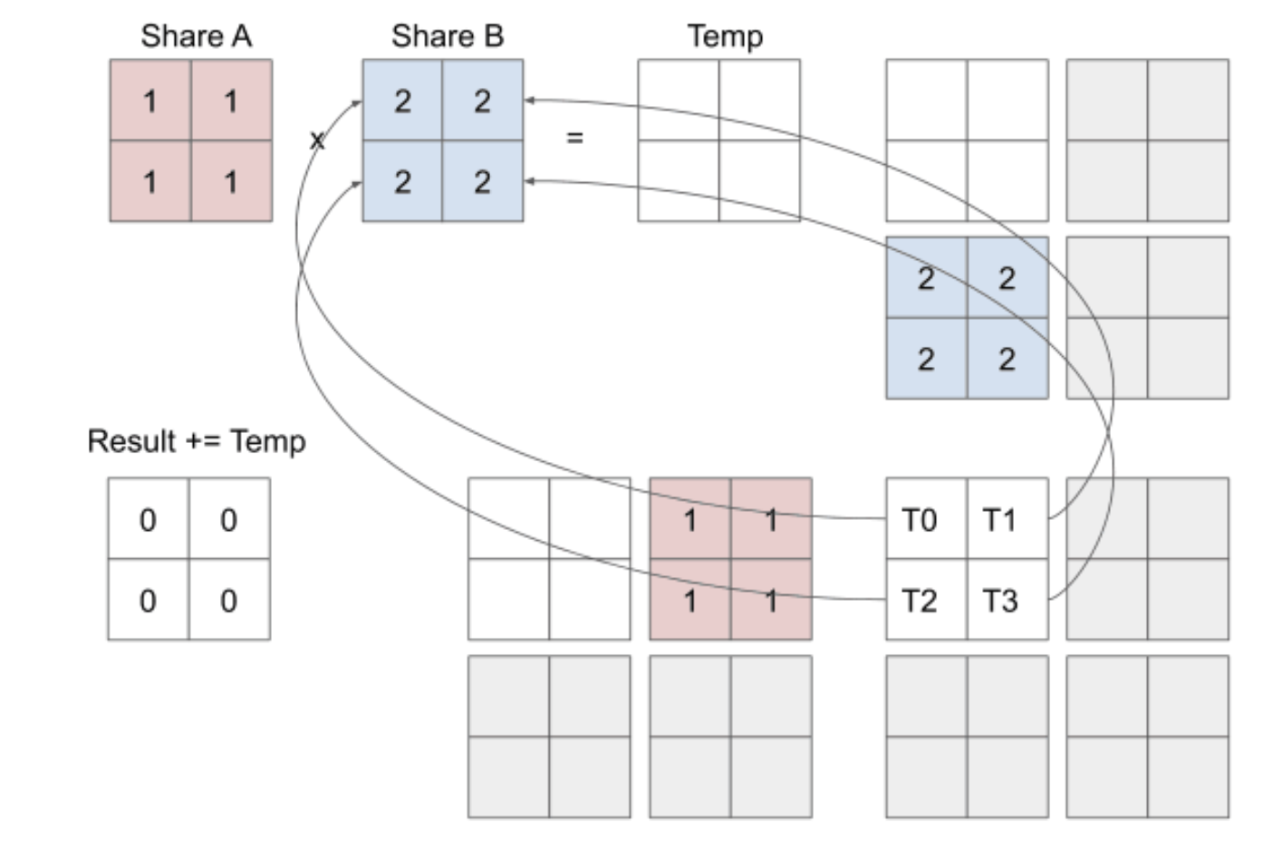
Methodology

Slide 15
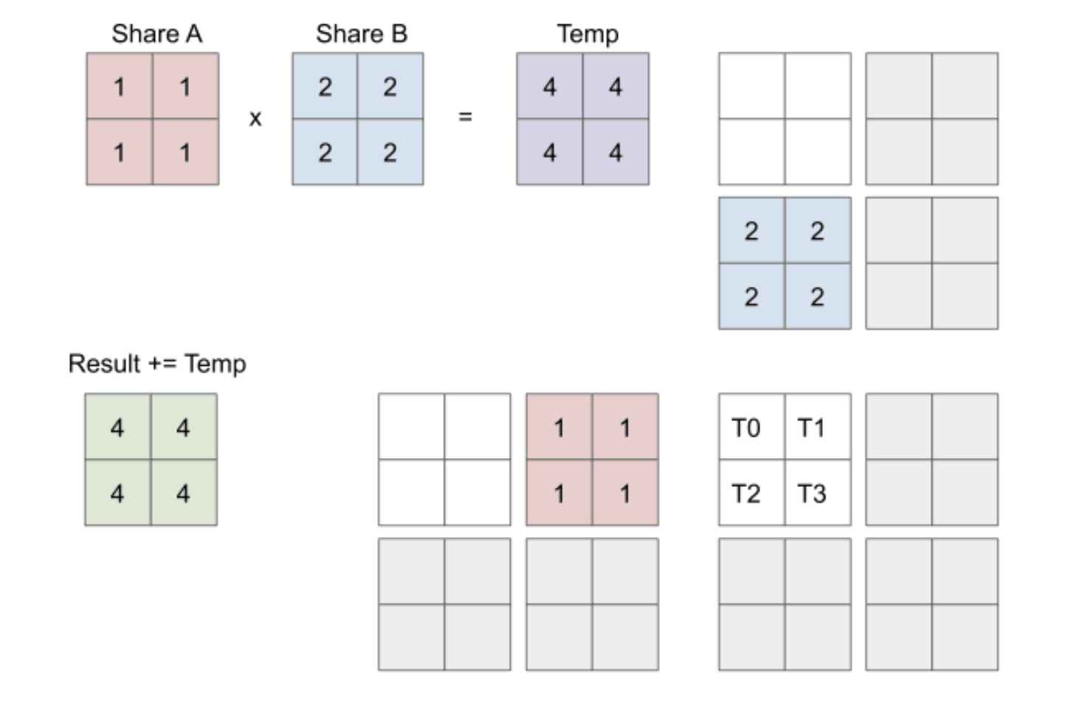
Methodology

Slide 16
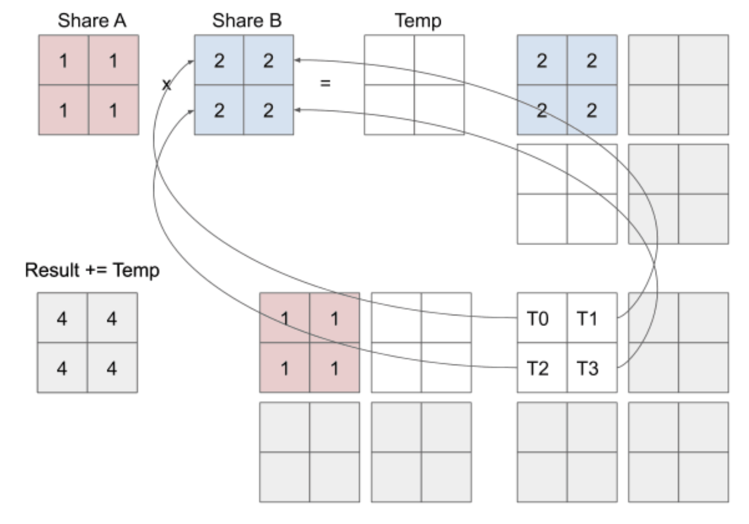
Methodology

Slide 17
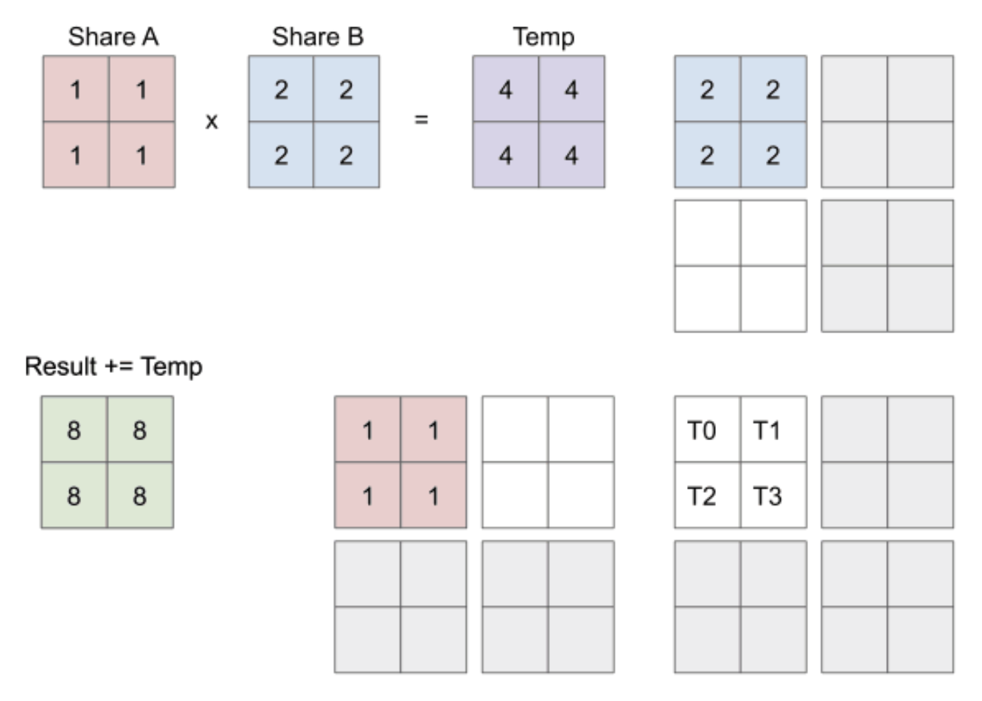
Methodology

Slide 18
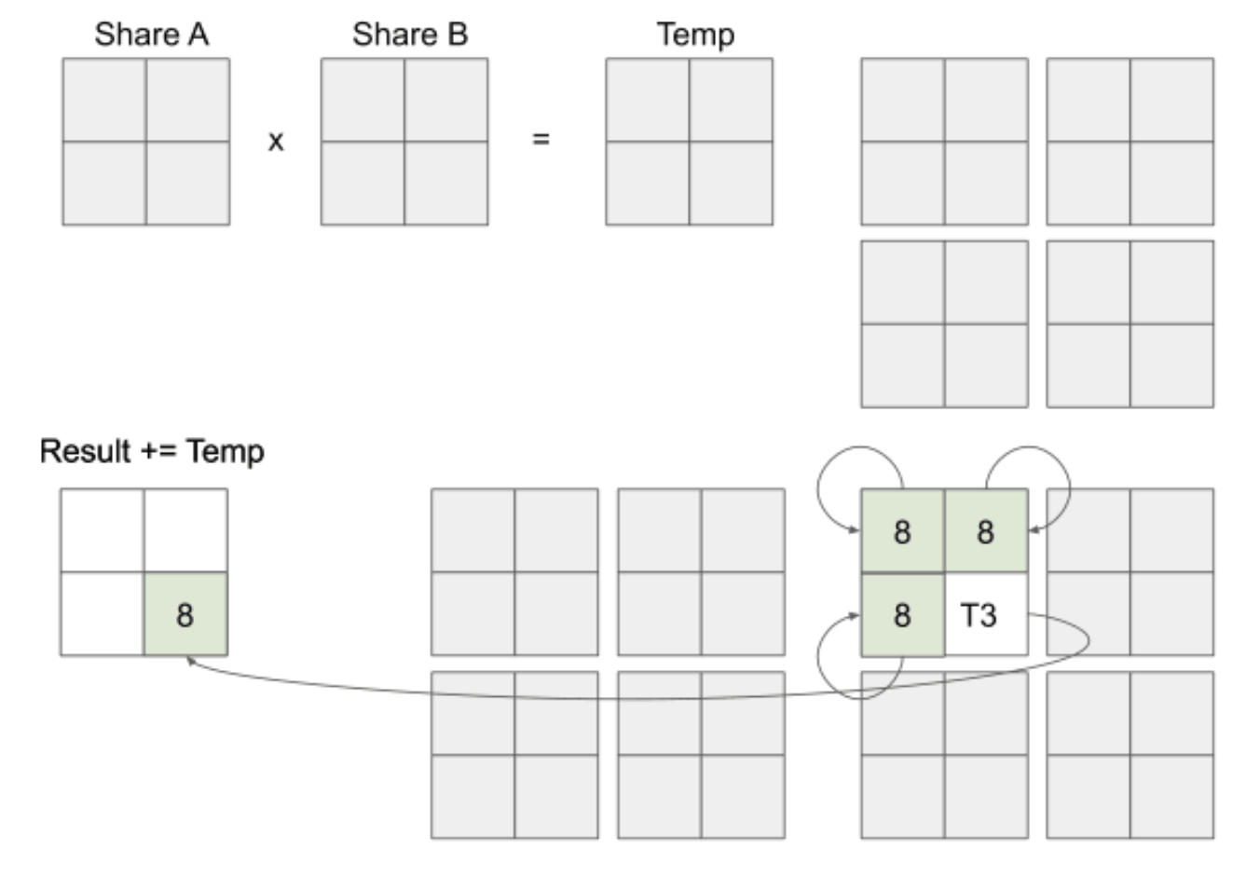
Methodology

Slide 19
Proof of Concept Demonstration

Slide 20
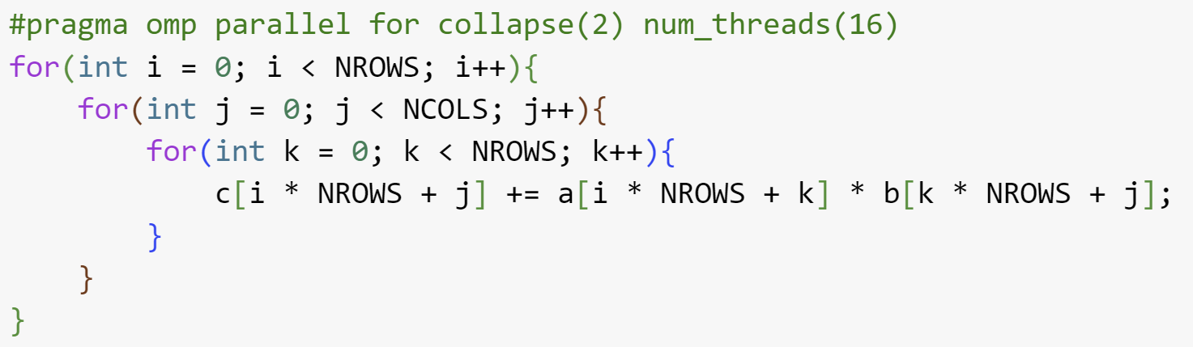
Proof of Concept Demonstration
On CPU (Serial)
On CPU (Using OpenMP)

Slide 21
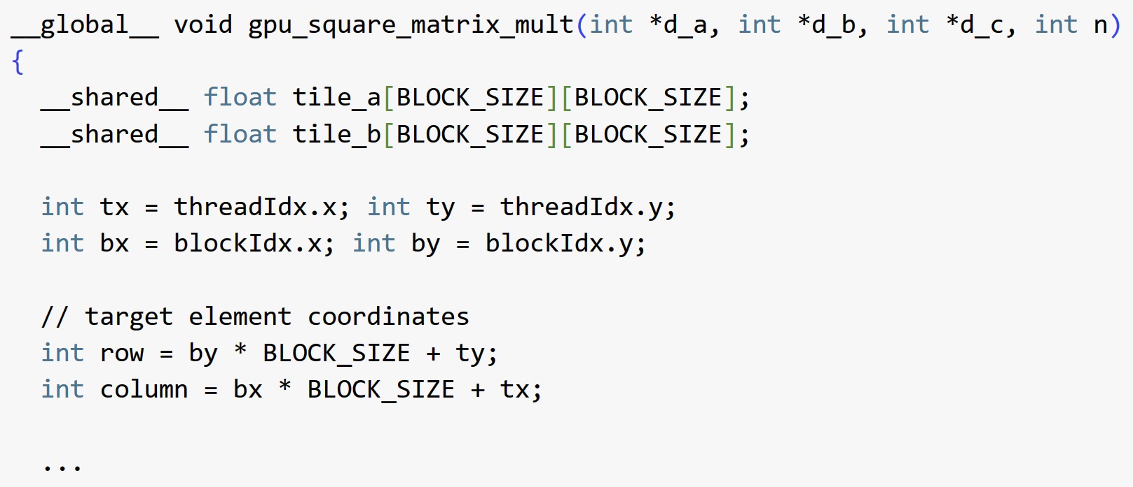
Proof of Concept Demonstration
On GPU (Using CUDA)
Number of Blocks
Number of Threads per Block

Slide 22
Analysis of Results

Slide 23
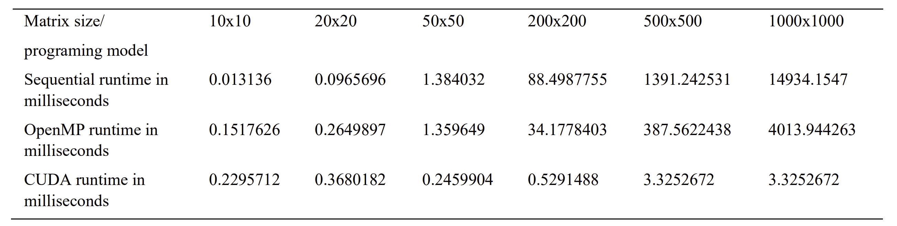
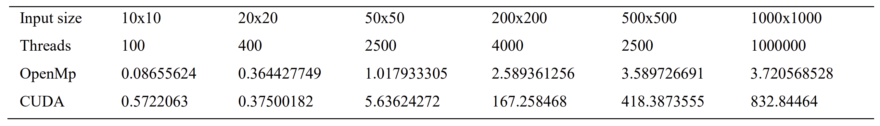
Analysis of Results
Computational Time Comparison
Speedup with Increasing Input Size
Table 2 : Runtime to Compute Product Matrix (Ghorpade et al., 2012)
Table 3 : Speedup (Ghorpade et al., 2012)

Slide 24
Conclusion

Slide 25
Conclusion
GPUs are faster than CPUs on computing matrix multiplication for large input sizes
GPUs are getting popular in the scientific computing community
High processing capability
Ease of availability
Support offered for programming (e.g. CUDA)
CUDA solves the problem of creating threads by hand and planning access to shared resources
Solution is (currently) limited to NVIDIA GPUs

Slide 26
Thank you!

Slide 27
References
Caulfield, B. (2009) “What’s the Difference between a CPU and a GPU?” NVIDIA Blog. Retrieved from CPU vs GPU? What’s the Difference? Which Is Better? | NVIDIA Blog
Ghorpade, J., Parande, J., Kulkarni, M., & Bawaskar, A. (2012). GPGPU processing in CUDA architecture. arXiv preprint arXiv:1202.4347. Retrieved from Microsoft Word - 9.docx (arxiv.org)
D. De Donno, A. Esposito, L. Tarricone and L. Catarinucci, "Introduction to GPU Computing and CUDA Programming: A Case Study on FDTD [EM Programmer's Notebook]," in IEEE Antennas and Propagation Magazine, vol. 52, no. 3, pp. 116-122, June 2010, doi: 10.1109/MAP.2010.5586593.
M. Cádenas-Montes, M. A. Vega-Rodríguez, J. J. Rodríguez-Vázquez and A. Gómez-Iglesias, "Accelerating Particle Swarm Algorithm with GPGPU," 2011 19th International Euromicro Conference on Parallel, Distributed and Network-Based Processing, Ayia Napa, Cyprus, 2011, pp. 560-564, doi: 10.1109/PDP.2011.33.
Murni, M., Bustamam, A., Ernastuti, E., Handhika, T., & Kerami, D. (2017). Hypergraph partitioning implementation for parallelizing matrix-vector multiplication using CUDA GPU-based parallel computing. In AIP Conference Proceedings (Vol. 1862, No. 1). AIP Publishing. Retrieved from pubs.aip.org/aip/acp/article/1862/1/030153/649626/Hypergraph-partitioning-implementation-for

Slide 28
References
Nagasaka, Y., Nukada, A., & Matsuoka, S. (2017, August). High-performance and memory-saving sparse general matrix-matrix multiplication for nvidia pascal gpu. In 2017 46th International Conference on Parallel Processing (ICPP) (pp. 101-110). IEEE. Retrieved from High-Performance and Memory-Saving Sparse General Matrix-Matrix Multiplication for NVIDIA Pascal GPU | IEEE Conference Publication | IEEE Xplore
Hochberg, R. (2012). Matrix multiplication with cuda-a basic introduction to the cuda programming model. SHODOR technical document, 266266. Retrieved from shodor.org/media/content/petascale/materials/UPModules/matrixMultiplication/moduleDocument.pdf
Jimale, A. O., Ridzuan, F., & Zainon, W. M. N. W. (2019). Square matrix multiplication using CUDA on GP-GU. Procedia Computer Science, 161, 398-405. Retrieved from Square Matrix Multiplication Using CUDA on GP-GU - ScienceDirect

